Slide 1
Discrete Mathematics
Dr. Han Huang
South China University of Technology
1

Slide 2
Chapter 1. Logic and Proof, Sets, and Function
Predicates and Quantifiers
Section 1.3
2

Slide 3
Contents
1
Introduction of Predicates
2
Quantifiers
3
Binding Variable
4
Translation
5
Application Example
3

Slide 4
Introduction of Predicates
4

Slide 5
Predicate Logic
We can use propositional logic to prove that certain real-life inferences are valid.
If it’s cold then it snows.
If it snows there are accidents
There are no accidents.
Therefore: It’s not cold
In propositional logic:
((c→s ∧s→a ∧¬a) →¬c) is a tautology
5

Slide 6
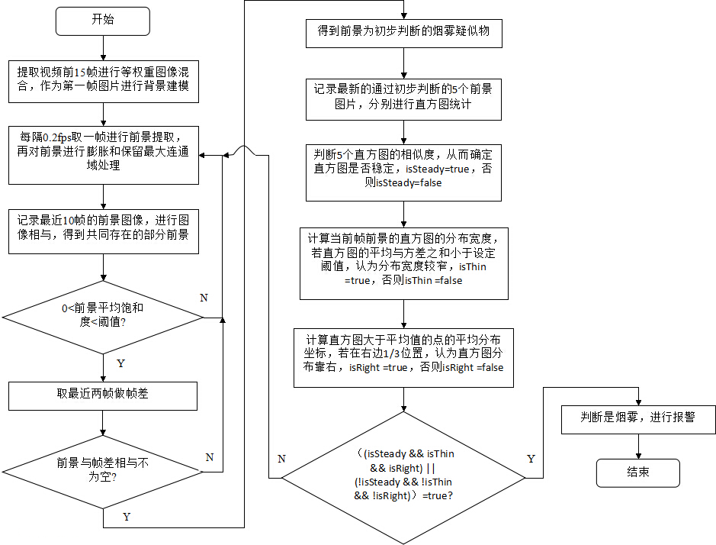
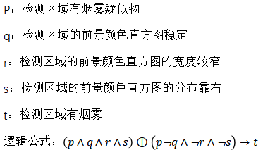
Example 1 ：视频烟雾检测
6

Slide 7
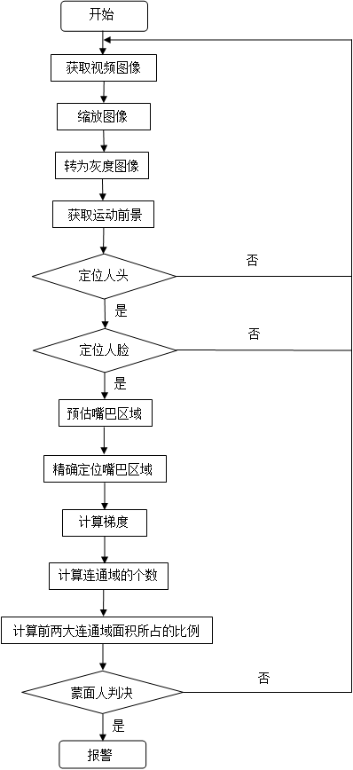
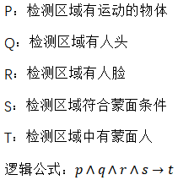
Example 2 ：视频蒙面检测
7

Slide 8
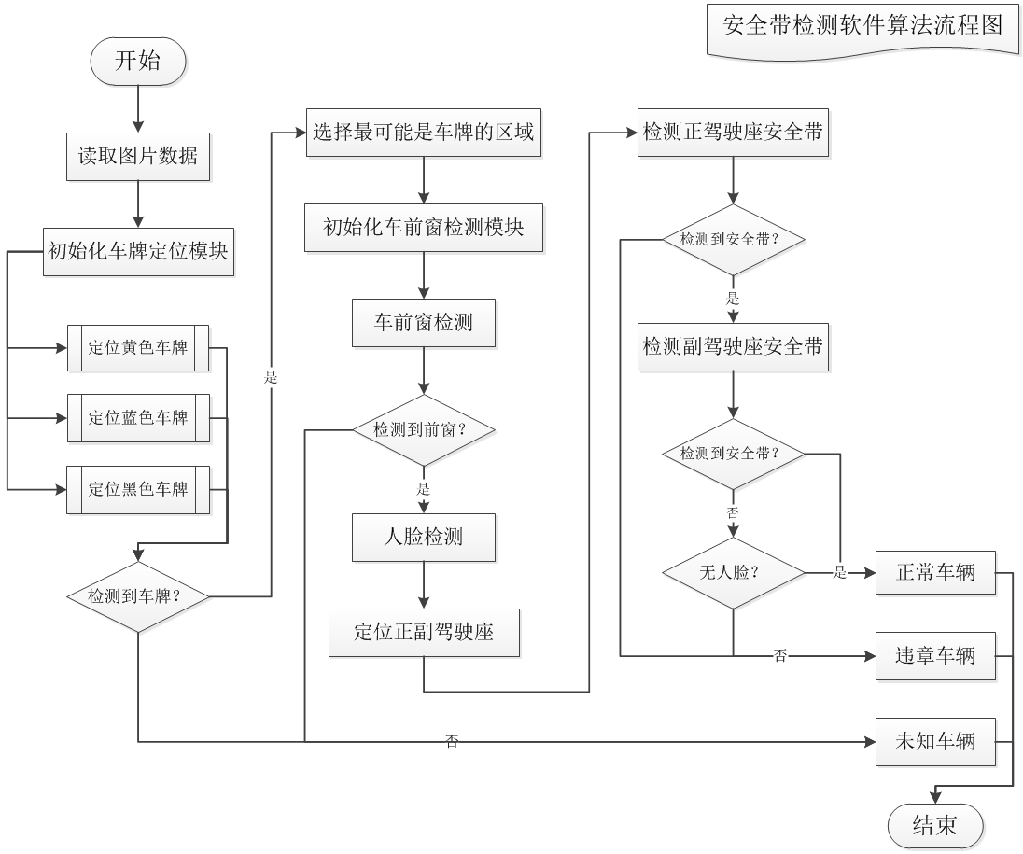
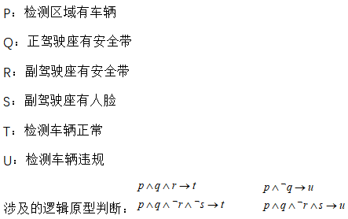
Example 3 ：视频监控的安全带检测
8

Slide 9
Predicate
9
Statement involving variables, such as
“x>3,” “x=y+3,” and “x+y=z”
These statement are neither true nor false when the values of the variables are not specified.

Slide 10
Propositional Function
Let’s denote “greater than 3” by P(x), where the predicate is “greater than 3” and x is the variable.
P(x) is said to be the value of the propositional function at x.
Example 1: Let P(x) denote “x>3”. What is the truth values of P(4) and P(2)?
P(4): 4>3, True
P(2): 2>3, False
10

Slide 11
Example 1
11
Let Q(x,y) denote the statement “x=y+3.” What are the truth values of the propositions Q(1,2) and Q(3,0)?
Q(1,2): “1=2+3” is false
Q(3,0): “3=0+3” is True

Slide 12
Example 2
What are the truth values of the propositions R(1,2,3) and R(0,0,1), where R(x,y,z) denotes “x+y=z”?
R(1,2,3): “1+2=3” is True.R(0,0,1): “0+0=1” is False.
Example 4
P(x): If x>0 then x=x+1.
12

Slide 13
Propositional Function
13
In general, a statement involving the n variables x1, x2,…, xn can be denoted by P(x1, x2,…, xn ).
A statement of the form P(x1, x2,…, xn ) is the value of the propositional function P at the n-tuple (x1, x2,…, xn ), and P is also called a predicate.

Slide 14
Quantifiers
14

Slide 15
Quantifier Expressions
Quantifiers provide a notation that allows us to quantify (count) how many objects in the u.d. satisfy a given predicate.
“∀” is the FOR ALL or universal quantifier. “∃” is the EXISTS or existential quantifier.
For example, ∀x P(x) and ∃x P(x) are propositions
15

Slide 16
Universal Quantification
16
Definition 1: The universal quantification of P(x) is the proposition “P(x) is true for all values of x in the universe or discourse”.
universal quantification of x is denoted as ∀x .
The proposition ∀x P(x) is read as
“for all x P(x) ” or “for every x P(x) ”
Universe of Discourse or Domain

Slide 17
Example: ∀
17
Let the u.d. be parking spaces at SCUT. Let P(x) be the prop. form “x is occupied” Then the universal quantification of P(x), ∀x P(x), is the proposition:
“All parking spaces at SCUT are occupied.”
“For each parking space at SCUT, that space is full.”
Before proceeding, we need to distinguish between two kinds of variables.
Notes:
17
Instructors: You can substitute your favorite overly-crowded destination in place of the University of Florida in this example.

Slide 18
Example 4
18
Let P(x) be the statement “x +1> x.” What is the truth value of the quantifications
∀x P(x), where the universe of discourse consists of all real numbers?
Solution: Since P(x) is true for all real numbers x, the quantification ∀x P(x)
is true.

Slide 19
Counterexample
To show that a statement of the form ¬∀x P(x) is a propositional function, we need only find one value of x in the universe of discourse for P(x) is false.
Such value of x is called a counterexample to the statement ∀x P(x).
19

Slide 20
Example 5
20
Let Q(x) be the statement “x<2.” What is the truth value of the quantification ∀x Q(x) where the universe of discourse consists of all real number?
Solution: Q(x) is not true for every real number x, since, for instance, Q(3) is false. Thus, ∀x Q(x) is false.

Slide 21
Example 6
21
What dose the statement ∀x P(x) mean if P(x) is “x has two parents” and the universe of discourse consists of all people?
Solution: The statement ∀x P(x) means “Every person has two parents.” This statement is true (except for clones).

Slide 22
Example 7
22
What is the truth value of ∀x (x^2>=x) if the universe of discourse consists of all real numbers and what is its truth value if the universe of discourse consists of all integers?
Solution: ∀x (x^2>=x) is false if the universe of discourse consists of all real numbers (since it is false for 0<x<1).
∀x (x^2>=x) is true if the universe of discourse consists of all integers.

Slide 23
Existential Quantifier
With existential quantification, we form a proposition that is true if and if only for P(x)
is true for at least one value of x in the universe of discourse.
Definition 2:
“There exists an element x in the universe of discourse such that P(x) is true.”
∃ is called existential quantifier.
23

Slide 24
Meaning of Quantified Expressions
∃x P(x) means there exist x in the u.d. (that is, 1 or more) such that P(x) is true.
∃x P(x) is read as
“There is an x such that P(x),”
“There is at least x such that P(x),”
or
“For some x P(x) ”
24

Slide 25
Example: ∃
Let the u.d. be the parking spaces at SCUT.
Let P(x) mean “x is full.” Then the existential quantification of P(x), ∃x P(x), is the proposition saying that
“Some parking space(s) at SCUT is/are full.”
“There is a parking space at SCUT that is full.”
“At least one parking space at SCUT is full.”
25

Slide 26
Example 8
26
Let P(x) denote the statement “x > 3.” What is the truth value ∃x P(x), where x is real number.
Solution: Since “x > 3” is true, for instance, when x=4. Thus, ∃x P(x) is true.

Slide 27
Example 9
27
Let Q(x) denote the statement “x = x + 1.” What is the truth value ∃x Q(x), where x is real number.
Solution: Since Q(x) is false for every real number, ∃x Q (x) is false.

Slide 28
28
∀x P(x)
When Ture? P(x) is true for every x.
When False? There is an x for which P(x) is false.
∃x P(x)
When Ture? There is an x for which P(x) is true.
When False? P(x) is false for every x.

Slide 29
Quantifier
∀x P(x)
P(x) is true for every x.
There is an x for which P(x) is false.
P(x1) ∧ P(x2) ∧… ∧ P(xn) is true if and only if P(x1),P(x2),…,P(xn) are all true.
∃ x P(x)
There is an x for which P(x) is false.
P(x) is false for every x.
P(x1) ∨ P(x2) ∨ … ∨P(xn) is true if and only if at least one of P(x1),P(x2),…,P(xn) is true.
29

Slide 30
Binding Variable
30

Slide 31
31
When a quantifier is used on the variable, we say that this occurrence of the variable is bound.
An occurrence of a variable that is not bound by quantifier or set equal to a particular value is said to be free.

Slide 32
Free and Bound Variables
32
An expression like P(x) is said to have a free variable x (i.e., x is not “defined”).
A quantifier (either ∀ or ∃) operates on an expression having one or more free variables, and binds one or more of those variables, to produce an expression having one or more bound variables.

Slide 33
Example of Binding
y
x
33
P(x,y) has 2 free variables, x and y.
∀x P(x,y) has 1 free variable, and one bound variable. [Which is which?]
Free because it is not bound by a quantifier and no value is assigned to this variable.

Slide 34
Occurrences of variables that are not free are bound.
Test your understanding: Which (if any) variables are free in
∃x ¬P(x)
¬∀x ¬P(x)
∃yQ(x)
∀xP(b) (NB, b is a constant)
∀x(∃y R(x,y))
34

Slide 35
Occurrences of variables that are not free are bound.
Check your understanding: Which (if any) variables are free in
∃x ¬P(x) [no free variables]
¬∀x ¬P(x) [no free variables]
∃yQ(x) [x is free]
∀xP(b) (NB, b is a constant) [no free var.]
∀x(∃y R(x,y)) [no free variables]
35

Slide 36
Negations
36
∀x P(x) is the statement “Every student in the class has taken a course in calculus.”
¬∀x P(x) ⇔ ∃x ¬ P(x)
It is the statement “There is a student in the class has not taken a course in calculus.”

Slide 37
Negations
37
∃x P(x) is the statement “There is a student in the class has taken a course in calculus.”
¬ ∃x P(x) ⇔ ∀ x ¬ P(x)
It is the statement “Every student in the class has not taken a course in calculus.”

Slide 38
Negating Quantifiers
38
¬ ∃x P(x) ⇔ ∀ x ¬ P(x)
When is Negation Ture? For every x, P(x) is false.
When False? There is an x for which P(x) is true.
¬∀x P(x) ⇔ ∃x ¬ P(x)
When is Negation Ture? There is an x for which P(x) is false.
When False? P(x) is true for every x.

Slide 39
De Morgan’s laws
¬(p(x1)∨ p(x2 ) … ∨ p(xn))
= ¬p(x1 ) ∧ ¬ p(x2 )… ∧ ¬ p(xn)
¬(p(x1) ∧ p(x2 ) … ∧ p(xn))
= ¬ p(x1 ) ∨ ¬ p(x2 )… ∨ ¬ p(xn)
39
39

Slide 40
Example 10
What are the negations of the statements “There is an honest politician” and “All Chinese eats jiaozi”?
Solution: Let H(x) denote “x is honest.”
“There is an honest politician.”
∃x H(x) ¬ ∃x H(x) ∀ x ¬ H(x)
Let C(x) denote “x eats jiaozi.”
“All Chinese eats jiaozi?”
∀x C(x) ¬ ∀x C(x) ∃x ¬ C(x)
40

Slide 41
Example 11
41
Negations of the statements ∀x ( x^2 > x) and ∃x ( x^2 = 2 )
¬ ∀x ( x^2 > x)
⇔ ∃x ¬ ( x^2 > x)
⇔ ∃x ( x^2 <= x)
¬ ∃x ( x^2 = 2 )
⇔ ∀x ¬ ( x^2 = 2 ) ⇔ ∀x ( x^2 != 2 )

Slide 42
Translation
42

Slide 43
Example 12
43
Express the statement “Every student in this class has studied calculus” using predicates and quantifier.
“x is in this class ” denoted as S(x)
“x has studied calculus” denoted as C(x)
The statement can be expressed as:
∀x (S(x) →C(x))
but not ∀x (S(x) ∧ C(x))

Slide 44
“x has studied subject y” denoted as Q(x,y)
“Every student in this class has studied calculus”
∀x (S(x) → Q(x , calculus))
44

Slide 45
Example 13
45
Express the statement “Some student in this class has visited Beijing” and “Every student in this class has visited either Shanghai or Beijing” using predicates and quantifier.
“x is a student in this class” is denoted as S(x)
“x has visited Beijing” is denoted as M(x)
“x has visited Shanghai ” is denoted as C(x)
∃x (S(x) ∧ M(x)) but not ∃x (S(x) → M(x))
∀x (S(x) ∧ (C(x) ∨ M(x))) ?

Slide 46
“For every person x, if x is a student in this class, then x has visited Beijing or x has visited Shanghai ”
∀x (S(x) → (C(x) ∨ M(x)))
“x has visited country y” is represented as V(x,y)
∀x (S(x) → (V (x , Beijing ) ∨ V (x , Shanghai )))
46

Slide 47
Application Example
47

Slide 48
Examples from Lewis Carrol
Lewis Carrol (really C.L. Dodgson writing under a pseudonym), the author of Alice in Wonderland, is also the author of several works on symbolic logic.
The given examples illustrate how quantifiers are used to express various type of statement.
48

Slide 49
Example 13
“All lions are fierce”
“Some lions do not drink coffee”
“Some fierce creatures do not drink coffee”
“x is lions” P(x) “x is fierce” Q(x)
“x drinks coffee” R(x)
∀x (P(x) → Q(x)) ∃ x (P(x) ∧ ¬ R(x))
∃ x (Q(x) ∧ ¬ R(x))
but not ∃ x (Q(x) → ¬ R(x))
49

Slide 50
Example 14
50
“All humming birds are richly colored.”
“No large birds live on honey.”
“Birds that do not live on honey are dull in color.” “Humming birds are small.”
“x is a humming bird” P(x)
“x is large” Q(x)
“x lives on honey” R(x)
“x is richly colored” S(x)

Slide 51
Example 14
51
“All humming birds are richly colored.”
∀x (P(x) → S(x))
“No large birds live on honey.”
¬ ∃ x (Q(x) ∧ R(x))
“Birds that do not live on honey are dull in color.” ∀x ( ¬ R(x) → ¬ S(x))
“Humming birds are small.”
∀x ( P(x) → ¬ Q(x))

Slide 52
Logic Programming
Prolog programs include a set of declarations consisting of two types of statements, Prolog facts and Prolog rules.
instructor(p, c)
p is the instructor of course c
enrolled(s, c)
s is enrolled in course c.
teaches(p, s) : instructor(p, c), enrolled(s, c)
p teaches student s
52

Slide 53
Example 15
53
instructor (chan, math273)
instructor (patel, ee222)
instructor (grossman, cs301)
enrolled (kevin, math273)
enrolled (juana, ee222)
enrolled (juana, cs301)
enrolled (kiko, math273)
enrolled (kiko, cs301)

Slide 54
enrolled (kevin, math273)
enrolled (X, math273)
teach (X, juana)
Yes
kevin
Kiko
patel
grossman
54

Slide 55
命题符号化
(1)某些实数是有理数
(2)会叫的狗未必会咬人
55

Slide 56
命题符号化
(1)某些实数是有理数
x是实数，R(x)
x是有理数, Q(x)
∃ x (R(x) ∧ Q(x))
(2)会叫的狗未必会咬人
x是会叫的狗，R(x)
x是会咬人的狗, Q(x)
∃ x (R(x) ∧ ¬ Q(x))
56

Slide 57
将命题翻译成自然语言
已给谓词如下：
E(x):x是偶数
N(x,y):x可以整除y
(1) (∃ x) (E (x) ∧ N(x,6))
(2) (∀x) (¬E (x) → ¬ N(2,x))
57

Slide 58
将命题翻译成自然语言
已给谓词如下：
E(x):x是偶数
N(x,y):x可以整除y
(1) (∃ x) (E (x) ∧ N(x,6))
存在一个可以整除6的偶数
(2) (∀x) (¬E (x) → ¬ N(2,x))
任意一个非偶数一定不被2整除
58

Slide 59
一阶逻辑
一阶逻辑（ First Order Logic ，又称谓词逻辑， Predicate Logic）用于形式化推理和表达复杂的数学和哲学概念。与传统的命题逻辑不同，一阶逻辑引入了更丰富的语法和语义元素，不仅可以表示命题之间的真假关系，还能够表达更复杂的概念和关系，以便更精确地描述和分析问题。
一阶逻辑公式包含量词（Quantifier，如∀,∃），逻辑运算符（Logical Operator，或称逻辑连接词，Logical Connective，如∧,∨,¬,⇒），变量（Variable，如x, y），以及谓词（Predicate，如P(x)）和函数（Function，如f(x)）。
59

Slide 60
一阶逻辑示例
谓词：M(x) 表示"x是一个男性"，F(x) 表示"x是一个女性"。
表达式：∀x (M(x) ∨ F(x)) 表示"每个人都是男性或女性"。
谓词：P(x) 表示"x是正数"，Q(x) 表示"x是偶数"。
表达式：∀x (P(x) → Q(x)) 表示"每个正数都是偶数"，∃x (P(x) ∧ Q(x)) 表示"存在一个既是正数又是偶数的数"。
谓词：N(x) 表示"x是一名护士"，D(x) 表示"x是一名医生"，S(x, y) 表示"x在星期y值班"。
表达式：∀x ((N(x) ∨ D(x)) ∧ ∀y (S(x, y) ∨ ¬S(x, y))) 表示"每个人都是护士或医生，并且每个人在每个星期要么值班，要么不值班"。
60

Slide 61

程序正确性验证
程序正确性验证：确保计算机程序按照规范执行并产生正确输出的过程。
一个程序正确性验证分为两个部分：
若程序终止，则获得正确的结果 （这证明了程序的部分正确性）
程序总是终止
61

Slide 62
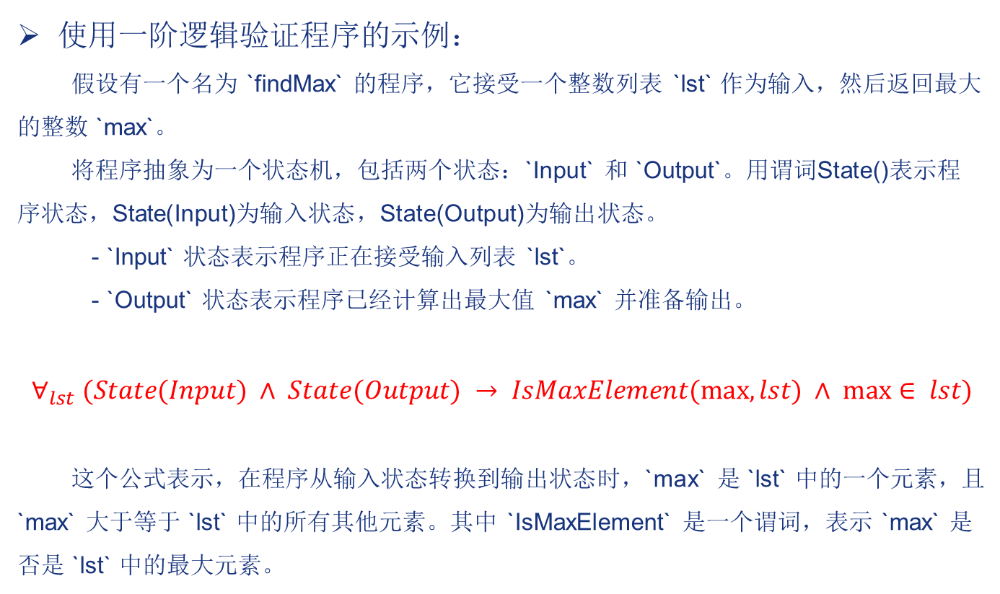
程序正确性验证
使用一阶逻辑验证程序的示例：
假设有一个名为 `findMax` 的程序，它接受一个整数列表 `lst` 作为输入，然后返回最大的整数 `max`。
将程序抽象为一个状态机，包括两个状态：`Input` 和 `Output`。用谓词State()表示程序状态，State(Input)为输入状态，State(Output)为输出状态。
- `Input` 状态表示程序正在接受输入列表 `lst`。
- `Output` 状态表示程序已经计算出最大值 `max` 并准备输出。
$$∀_{lst} (State(Input) ∧ State(Output) → IsMaxElement(max, lst) ∧ max⁡∈ lst)$$
这个公式表示，在程序从输入状态转换到输出状态时，`max` 是 `lst` 中的一个元素，且 `max` 大于等于 `lst` 中的所有其他元素。其中 `IsMaxElement` 是一个谓词，表示 `max` 是否是 `lst` 中的最大元素。
62

Slide 63
霍尔逻辑
一阶逻辑验证程序的局限性：
一阶逻辑是不完备的，无法用来表示和验证某些复杂的性质和属性。
对于大型程序，一阶逻辑规范可能会变得非常复杂，导致验证变得困难。
霍尔逻辑（Floyd-Hoare Logic）是一套由英国计算机科学家霍尔（C. A. R. Hoare）开发的形式系统，主要是用于推理验证程序的正确性。相比于一阶逻辑，霍尔逻辑更加完备，有更好的表达能力。
63

Slide 64
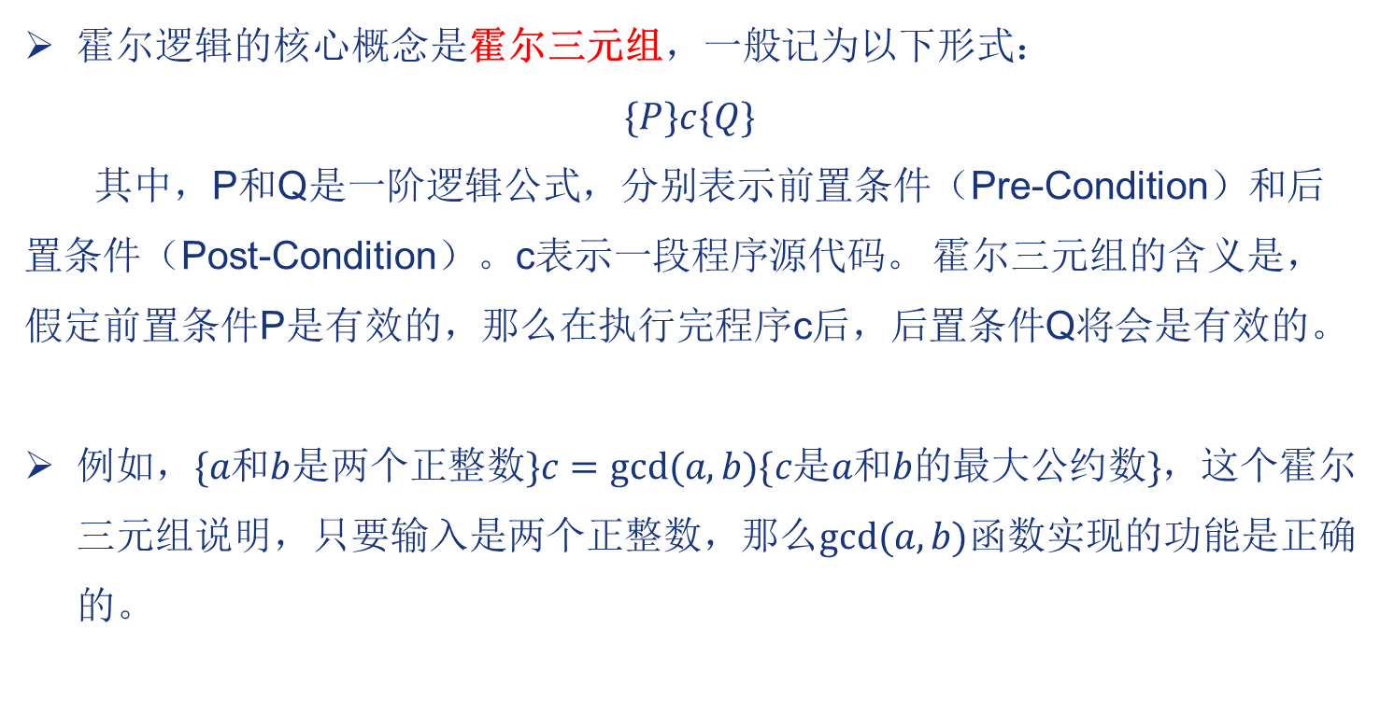
霍尔逻辑
霍尔逻辑的核心概念是霍尔三元组，一般记为以下形式：
$$\{P\}c\{Q\}$$
其中，P和Q是一阶逻辑公式，分别表示前置条件（Pre-Condition）和后置条件（Post-Condition）。c表示一段程序源代码。 霍尔三元组的含义是，假定前置条件P是有效的，那么在执行完程序c后，后置条件Q将会是有效的。
例如，$\{a和b是两个正整数\}c=gcd⁡(a,b)\{c是a和b的最大公约数\}$，这个霍尔三元组说明，只要输入是两个正整数，那么$gcd⁡(a,b)$函数实现的功能是正确的。
64

Slide 65
霍尔逻辑示例
def add(a, b):
"""
计算两个整数的和
:param a: 第一个整数
:param b: 第二个整数
:return: 两个整数的和
"""
result = a + b
return result
前置条件：{a是整数, b是整数}
后置条件：{result == a + b}
def factorial(n):
"""
计算给定整数n的阶乘
:param n: 非负整数
:return: n的阶乘
"""
if n == 0:
return 1
else:
result = 1
for i in range(1, n + 1):
result *= i
return result
前置条件：{ n >= 0 }
后置条件：{ result == n! }
65

Slide 66
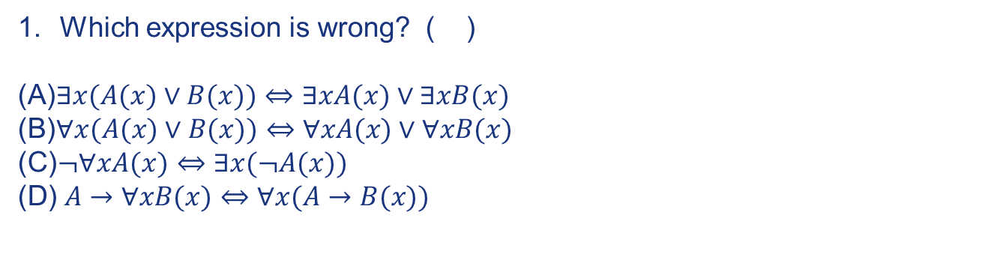
Exercises
1
66
66

Slide 67
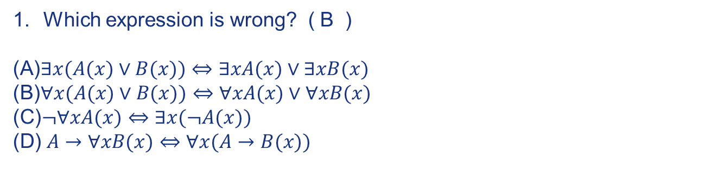
Exercises
1
∀x(P (x) ∨ Q(x)) ⇔ ∀xP (x) ∨ ∀xQ(x)
∃x(P (x) ∧ Q(x)) ⇔ ∃ xP (x) ∧ ∃xQ(x)
67
67

Slide 68
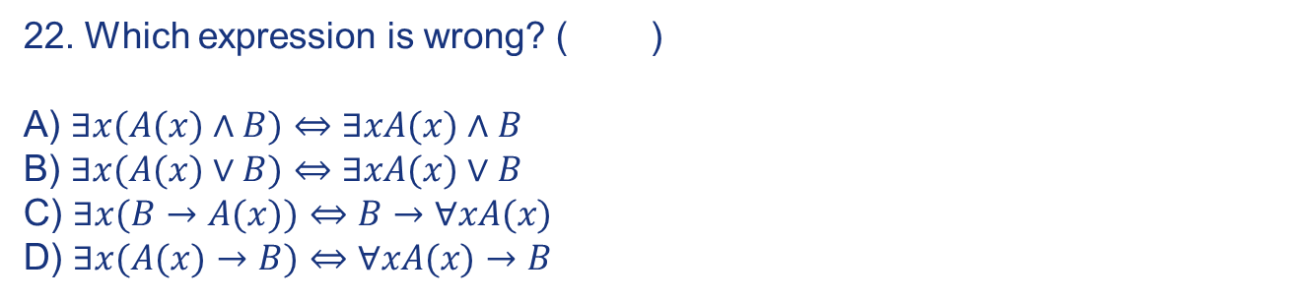
Exercises
2
68
68

Slide 69
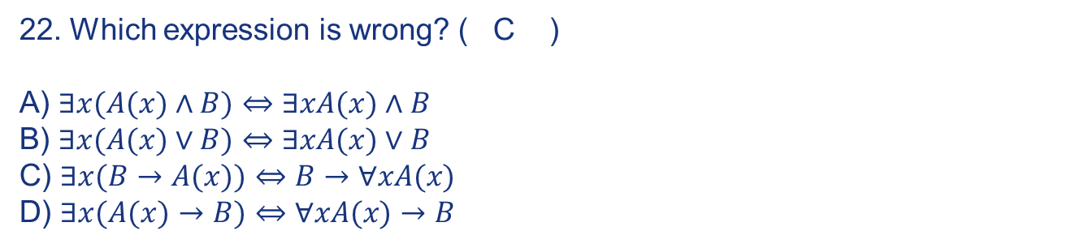
Exercises
2
69
69

Slide 70
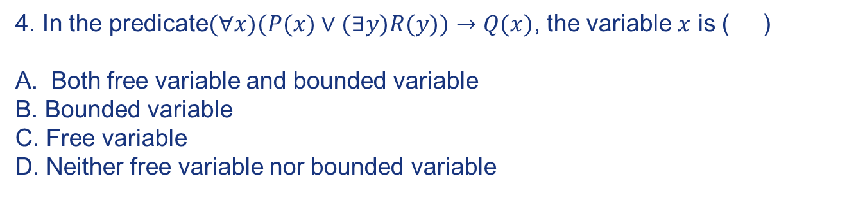
Exercises
3
70
70

Slide 71

Exercises
3
71
71

Slide 72
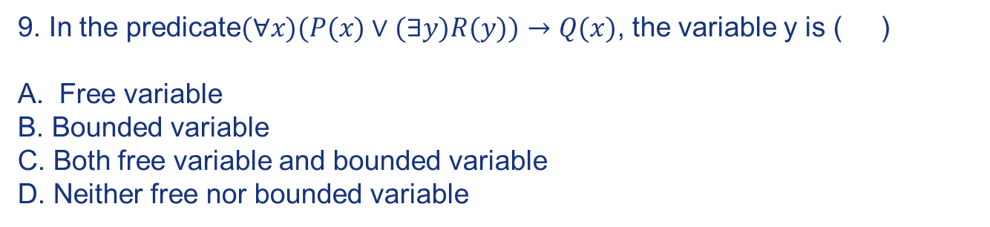
Exercises
4
72
72

Slide 73
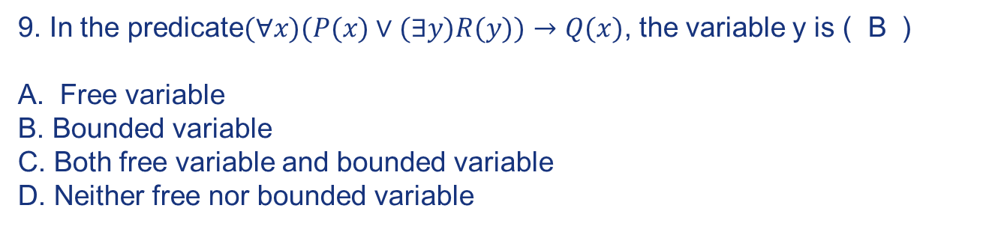
Exercises
4
73
73

Slide 74
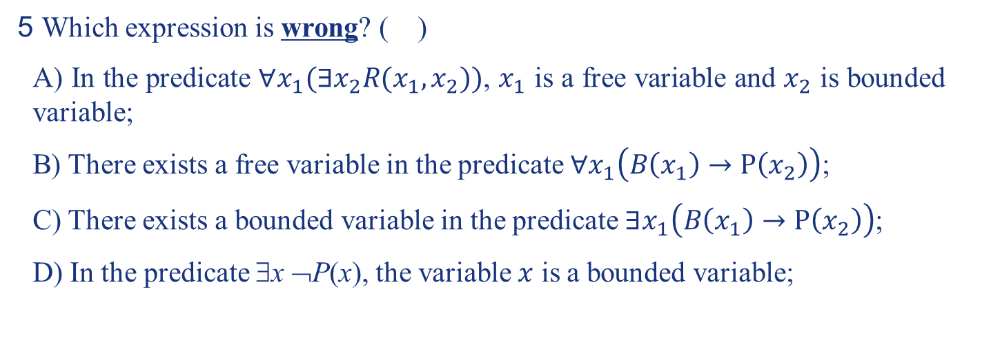
Exercises
A
5 Which expression is wrong? ( )
A) In the predicate $∀x_{1}(∃x_{2}R(x_{1},x_{2}))$, $x_{1}$ is a free variable and $x_{2}$ is bounded variable;
B) There exists a free variable in the predicate $∀x_{1}\left(B\left(x_{1}\right)→P\left(x_{2}\right)\right)$;
C) There exists a bounded variable in the predicate $∃x_{1}\left(B\left(x_{1}\right)→P\left(x_{2}\right)\right)$;
D) In the predicate ∃x ¬P(x), the variable $x$ is a bounded variable;
74
74

Slide 75
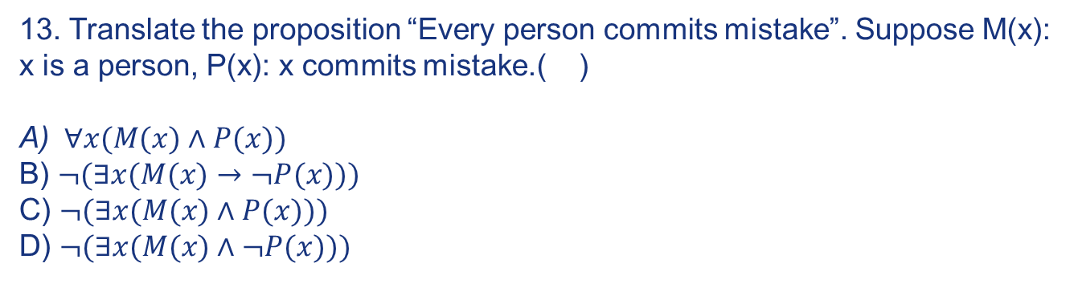
Exercises
6
75
75

Slide 76
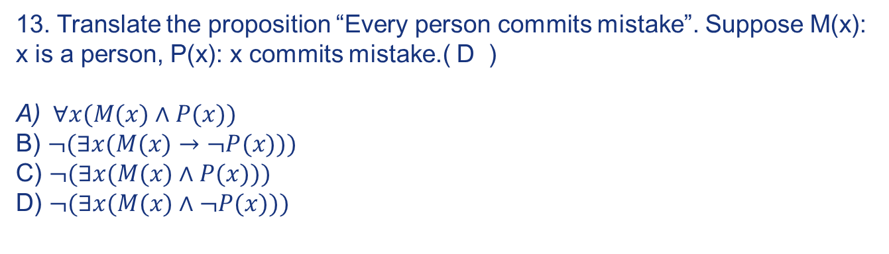
Exercises
6
76
76

Slide 77


Exercises
7 Let $P(x)$be “x is robot”, and $Q(x)$ be “x can play chess”. Express the negation of proposition “Some robots can play chess” using predicates and quantifier:
$$\left(∀x\right)\left(¬P\left(x\right)∨¬Q\left(x\right)\right)$$
77
77

Slide 78
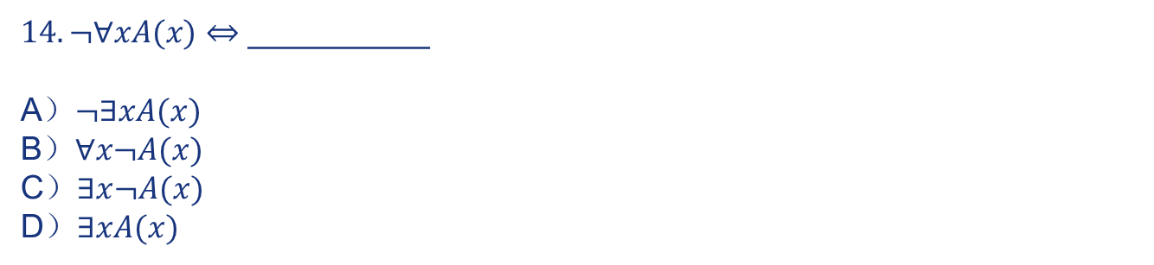
Exercises
8
78
78

Slide 79
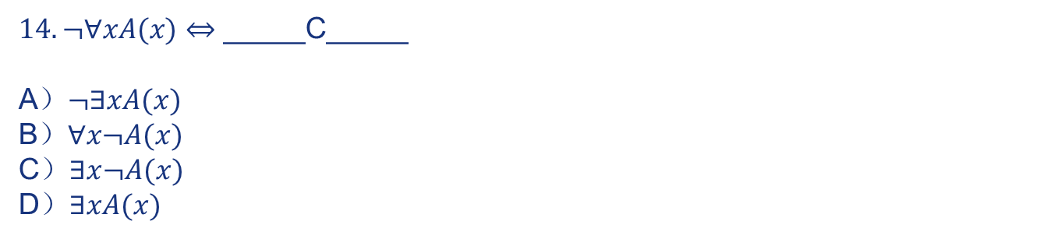
Exercises
8
79
79

Slide 80
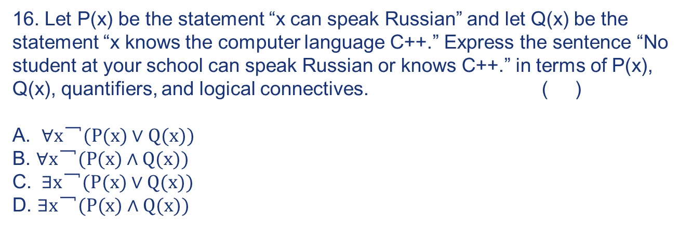
Exercises
9
80
80

Slide 81
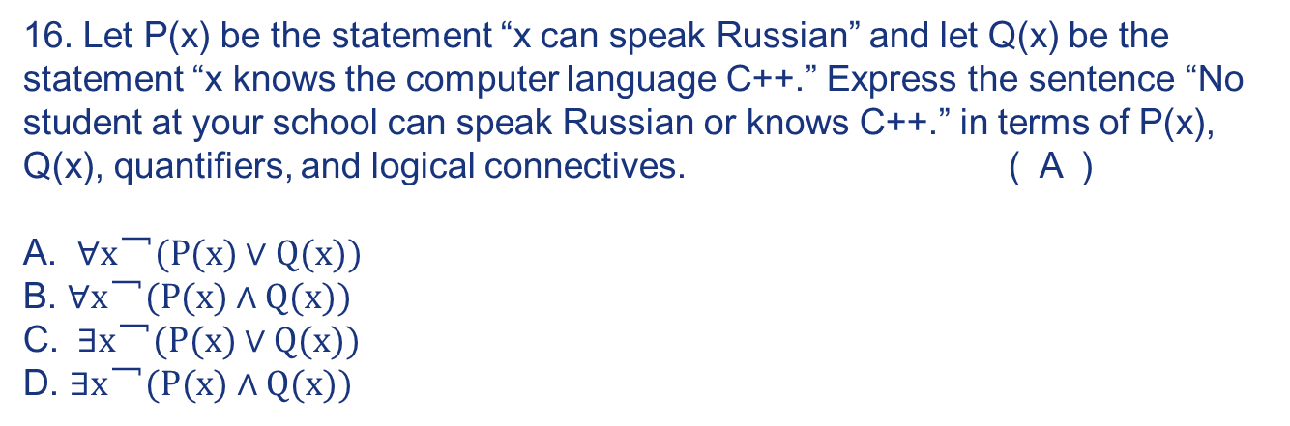
Exercises
9
81
81

Slide 82
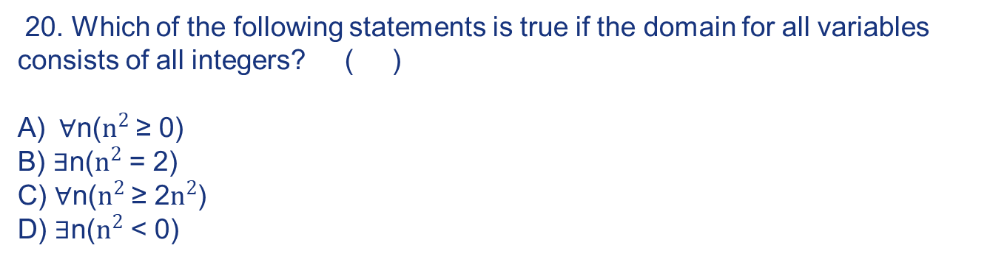
Exercises
10
82
82

Slide 83
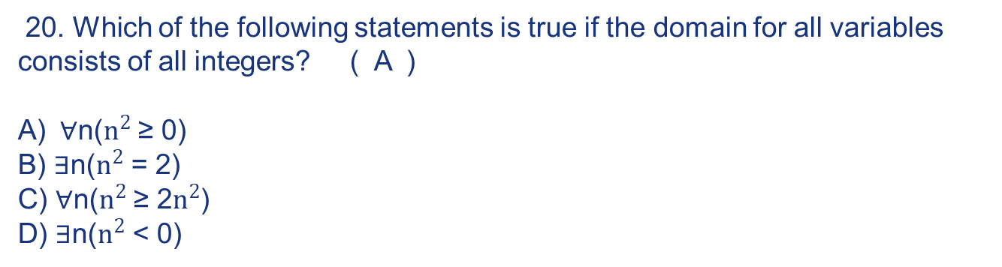
Exercises
9
10
83
83

Slide 84
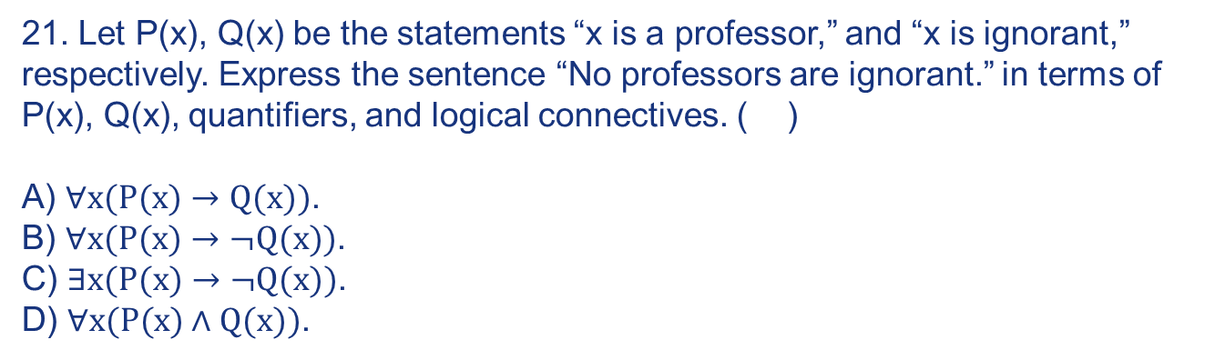
Exercises
11
84
84

Slide 85
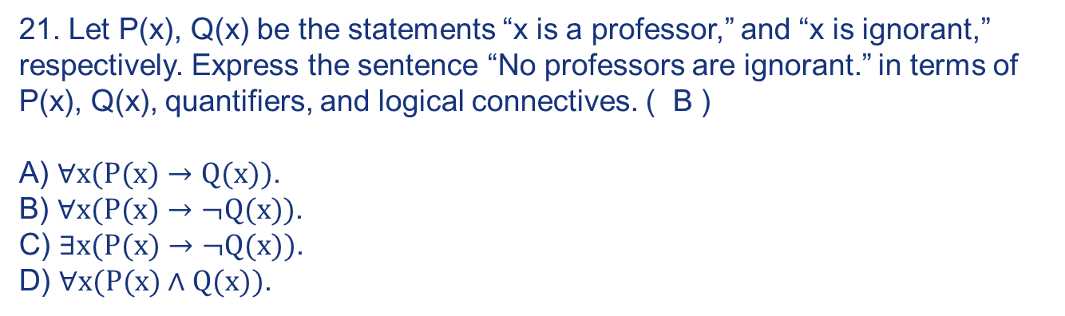
Exercises
11
85
85

Slide 86
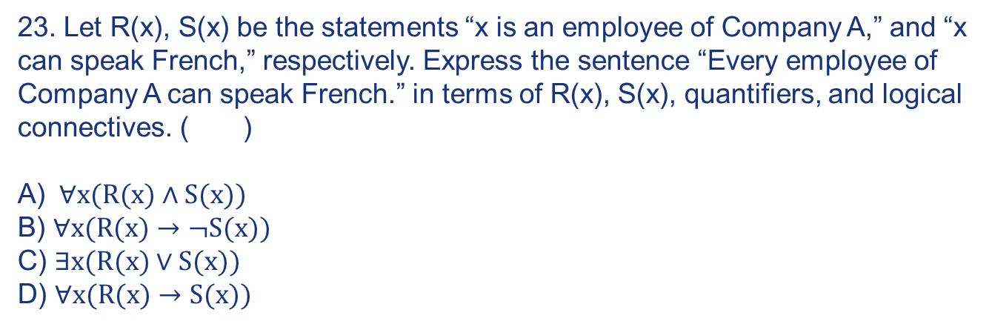
Exercises
12
86
86

Slide 87
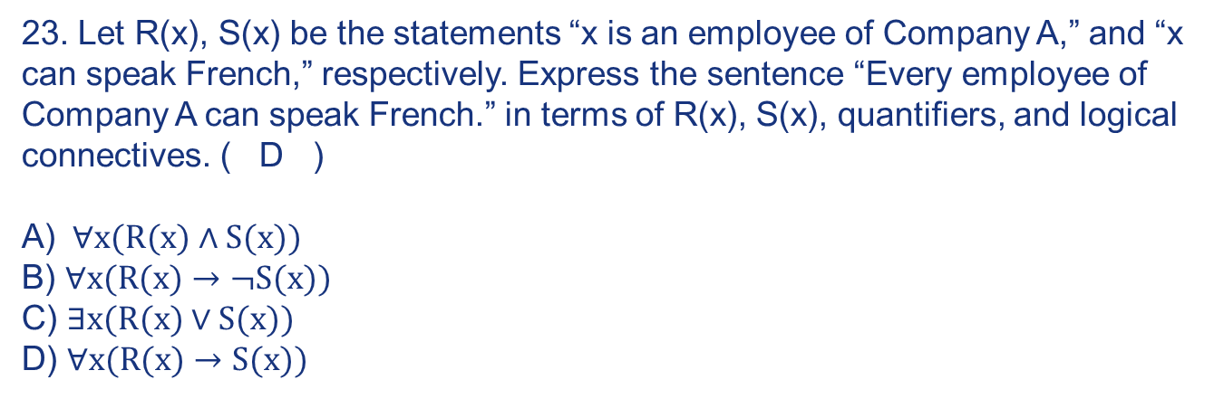
Exercises
12
87
87

Slide 88
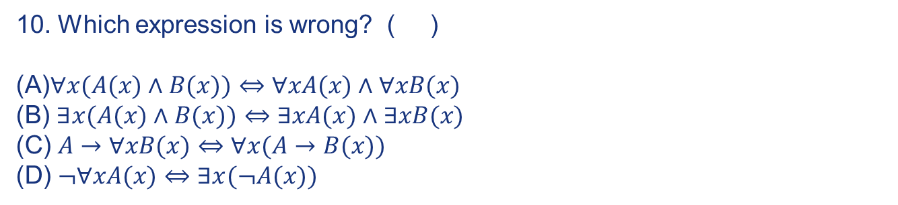
Exercises
13
88
88

Slide 89
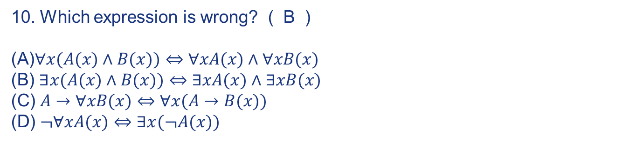
Exercises
13
89
89

Slide 90
Exercises
14
90
90

Slide 91
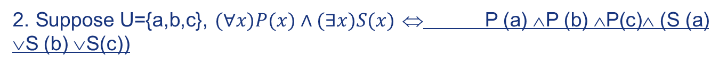
Exercises
14
91
91

Slide 92
Exercises
15
6. Let predicate S(x, y) be “x is in state y” and E(x) be “x is an abnormal system” where the domain for x and y consists of all systems and all possible states, respectively. Translate “Each abnormal system is in malfunctioning state, otherwise in diagnostic state.” to specifications in logical expression as____
92
92

Slide 93
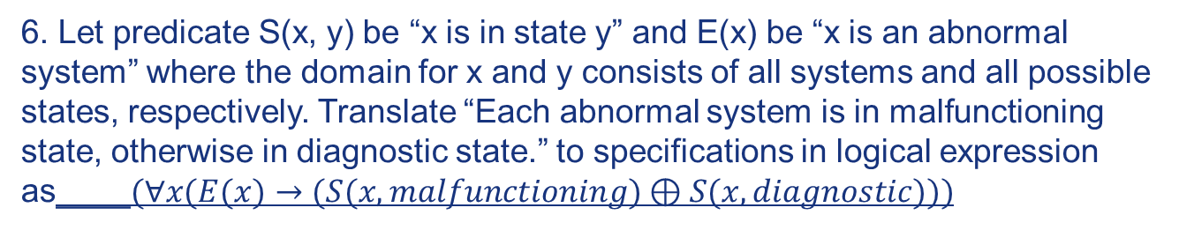
Exercises
15
93
93

Slide 94
Exercises
16
15. Let P(x) be the statement “x can speak Russian” and let Q(x) be the statement “x knows the computer language C++.” For the universe of discourse for quantifiers use the set of all students at your school. Express the following sentences in terms of P(x), Q(x), quantifiers and logical connectives.
There is a student at your school who can speak Russian but who doesn’t know C++.
___________________________
94
94

Slide 95
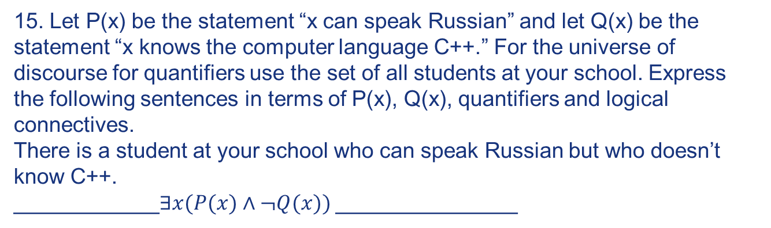

Exercises
16
95
95

Slide 96
Exercises
17. “x is in this class ” is denoted as S(x), and“x has studied discrete mathematics” is denoted as C(x). Using predicates and quantifier, the statement “Every student in this class has studied discrete mathematics.” can be expressed as:
96
96

Slide 97

Exercises
17. “x is in this class ” is denoted as S(x), and“x has studied discrete mathematics” is denoted as C(x). Using predicates and quantifier, the statement “Every student in this class has studied discrete mathematics.” can be expressed as:
97
97

Slide 98
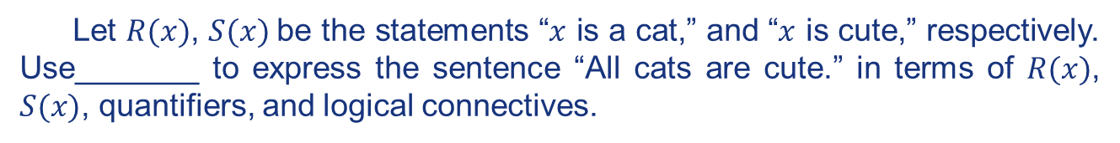
Exercises
16
18.
98
98

Slide 99
Exercises
16
18.
∀x (R(x) →S(x))
99
99

Slide 100
Exercises
3. “x is a student in this class” is denoted as S(x). “x has visited Mexico” is denoted as M(x). “x has visited Canada” is denoted as C(x).Express the statement “For every person x, if x is a student in this class, then x has visited Mexico or x has visited Canada” using predicates and quantifier ___.
19
100
100

Slide 101


Exercises
3. “x is a student in this class” is denoted as S(x). “x has visited Mexico” is denoted as M(x). “x has visited Canada” is denoted as C(x).Express the statement “For every person x, if x is a student in this class, then x has visited Mexico or x has visited Canada” using predicates and quantifier ___∀x (S(x) → (M(x) ∨C(x))).
19
101
101

Slide 102
Exercises
20
102
102

Slide 103
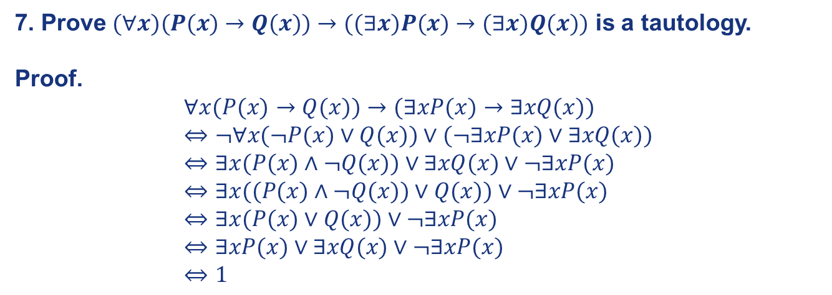
Exercises
20
103
103

Slide 104
End of the Section 1.3
104
104

